Slide 1


Laszlo Pal Danyi
28-JUL-2024

Slide 2


Outline
Executive Summary
Introduction
Methodology
Results
Conclusion
Appendix

Slide 3

Executive Summary
Summary of methodologies
Data collection through:
API
Web scraping
Data Wrangling
Exploratory Data Analysis (EDA) with:
SQL
Data Visualization
Interactive GEO Data visualization using Folium Map
Machine Learning (ML) Algorithms for Prediction
Summary of all results
Exploratory Data Analysis results
Interactive Chart/Visualization results
Predictive Analysis results

Slide 4
Introduction
Project background and context
SpaceX advertises Falcon 9 rocket launches on its website, with a cost of 62 million dollars; other providers cost upward of 165 million dollars each, much of the savings is because SpaceX can reuse the first stage. Therefore if we can determine if the first stage will land, we can determine the cost of a launch. This information can be used if an alternate company wants to bid against SpaceX for a rocket launch.
Problems you want to find answers
Determine the factors that most significantly influence:
Whether the Falcon 9 first stage will land successfully
The various factors of a successful mission.

Slide 5

Section 1

Slide 6
Methodology
Executive Summary
Data collection methodology:
Data was collected through SpaceX API and web scraping from Wikipedia
Perform data wrangling
Data was cleansed, organized and applied one-hot encoding for feature classification.
Perform exploratory data analysis (EDA) using visualization and SQL
Perform interactive visual analytics using Folium and Plotly Dash
Perform predictive analysis using classification models
How to build, tune, evaluate classification models

Slide 7
Data Collection
Data Collection Process:
Initial Research:
Identified key data sources and gathered preliminary information.
Determined the scope of data needed for analysis (e.g., launch dates, outcomes, payload details).
API Integration:
Connected to the SpaceX API to fetch data on all historical launches.
Parsed and stored the data in a structured format (e.g., JSON, CSV).
Web Scraping:
Used Beautiful Soup to scrape data from Wikipedia about Falcon 9 launches.
Extracted relevant details such as launch site information, mission descriptions, and booster versions.
Converted the extracted data into a Pandas DataFrame for further processing.
Data Cleaning:
Cleaned and preprocessed the collected data to ensure consistency.
Handled missing values, removed duplicates, and standardized formats.

Slide 8
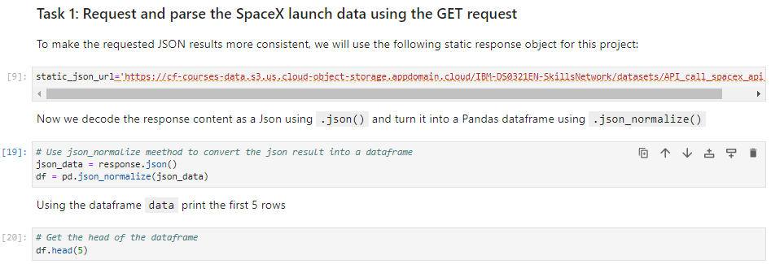
Data Collection – SpaceX API
We collected data using SpaceX REST API calls, integrating and processing it into a clean, comprehensive dataset using Pandas. The workflow included API integration, data extraction, cleaning, merging, and validation to ensure data accuracy and completeness.
https://github.com/Haseulhoff/SpaceX-FinalAssignment/blob/main/jupyter-labs-spacex-data-collection-api%20(SPCXPT1)-LPD.ipynb

Slide 9
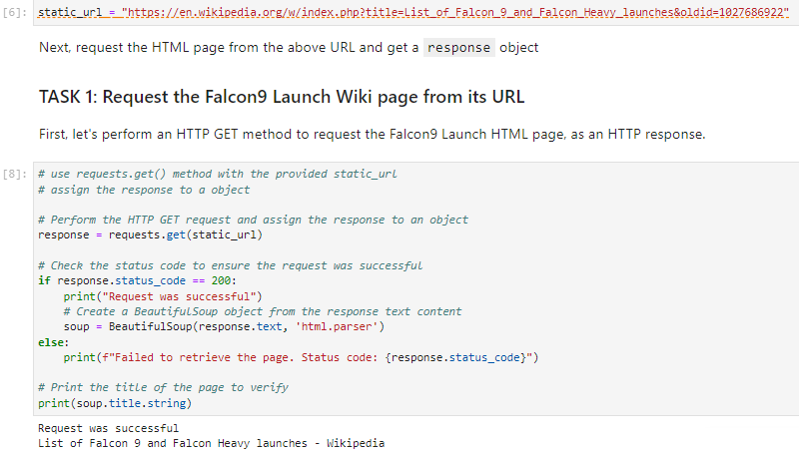
Data Collection - Scraping
We employed web scraping using Beautiful Soup to extract Falcon 9 launch data from Wikipedia. The process involved parsing HTML content, extracting relevant information, handling missing values, and formatting the data into a structured Pandas DataFrame.
https://github.com/Haseulhoff/SpaceX-FinalAssignment/blob/main/jupyter-labs-webscraping%20(spcxpt1.2)-LPD.ipynb

Slide 10
Data Wrangling
Data wrangling involved cleaning and transforming the collected data to ensure it was suitable for analysis.
This process included handling missing values, standardizing formats, converting data types, and creating new variables.
Additionally, we computed the number of launches by each launch site and the occurrences of different orbits to gain more insights.
https://github.com/Haseulhoff/SpaceX-FinalAssignment/blob/main/labs-jupyter-spacex-Data%20wrangling%20(spcxpt2.0)-LPD.ipynb

Slide 11
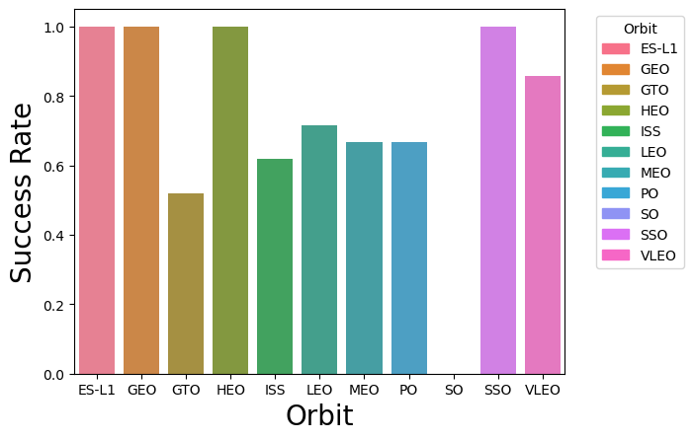
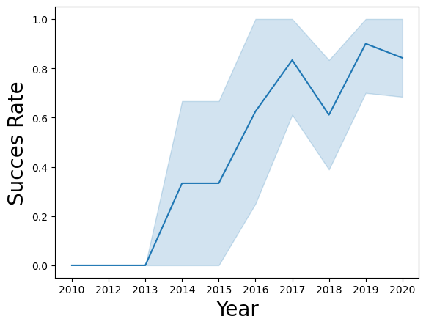
EDA with Data Visualization
We deep dived into details and analyzed certain features, such as Launch Sites, Orbits, Payload Mass trends of outcomes and for better insights we created charts that allows us to gain knowledge.
https://github.com/Haseulhoff/SpaceX-FinalAssignment/blob/main/edadataviz(spcxpt4.1)-LPD.ipynb

Slide 12
EDA with SQL
Extracted relevant columns from the SpaceX launch dataset.
Retrieved records for specific launch sites.
Counted the number of successful and failed launches.
Summarized the total payload mass for each launch site.
Extracted records for specific orbit types.
Retrieved the number of launches for each launch site and orbit combination.
Sorted the dataset by payload mass in descending order.
Filtered payload mass records within a specific date range.
https://github.com/Haseulhoff/SpaceX-FinalAssignment/blob/main/jupyter-labs-eda-sql-coursera_sqllite-(spcxpt3)-LPD.ipynb

Slide 13
Build an Interactive Map with Folium
Map Objects Added to Folium Map:
Markers and circles:
Classification: Markers and circles were used to indicate launch sites with distinct colors or symbols based on the classification of launch success (0 for unsuccessful, 1 for successful).
Rationale: To visually distinguish between successful and unsuccessful launches at each site, aiding in the analysis of launch performance.
Lines:
Distance Calculation: Lines were drawn to show distances between launch sites and various proximities such as highways, railways, and coastlines.
Rationale: To illustrate the geographical context and proximity of launch sites to critical infrastructure, aiding in the assessment of logistical and environmental factors affecting launch success.
https://github.com/Haseulhoff/SpaceX-FinalAssignment/blob/main/lab_jupyter_launch_site_location-(spcxpt4.2)LPD.ipynb

Slide 14
Build a Dashboard with Plotly Dash
Dropdown List for Launch Site Selection:
Description: Allows users to select a specific launch site or view data for all sites.
Rationale: Enables focused analysis on individual sites or comparisons across all sites.
Pie Chart for Launch Success Counts:
Description: Displays total launch counts by site or success/failure counts for a selected site.
Rationale: Provides a clear visual representation of launch distributions and success rates.
Range Slider for Payload Selection:
Description: Allows users to select a payload range (kg).
Rationale: Facilitates analysis of how different payload ranges affect launch success rates.
Scatter Chart for Payload vs. Launch Success:
Description: Shows the correlation between payload mass and launch success, with points colored by booster version.
Rationale: Visualizes the relationship between payload size and launch outcomes.
https://github.com/Haseulhoff/SpaceX-FinalAssignment/blob/main/spacex_dash_app.py

Slide 15
Predictive Analysis (Classification)
Model Development Process:
Developed, tested, and optimized models (Logistic Regression, SVM, Decision Tree, KNN) to predict Falcon 9 first stage landing success using GridSearchCV. Split data into training and test sets and calculated accuracy scores.
Standardized features and optimized hyperparameters for best performance.
https://github.com/Haseulhoff/SpaceX-FinalAssignment/blob/main/SpaceX_Machine%20Learning%20Prediction_Part_5-LPD.ipynb

Slide 16

Results
Exploratory Data Analysis: Analyzed launch success rates, payload distributions, and launch site frequencies using visualizations.
Interactive Analytics Demo: Created interactive dashboards with pie charts and scatter plots to showcase launch outcomes.
Predictive Analysis: Built and evaluated multiple classification models to identify the best-performing one.

Slide 17

Section 2

Slide 18
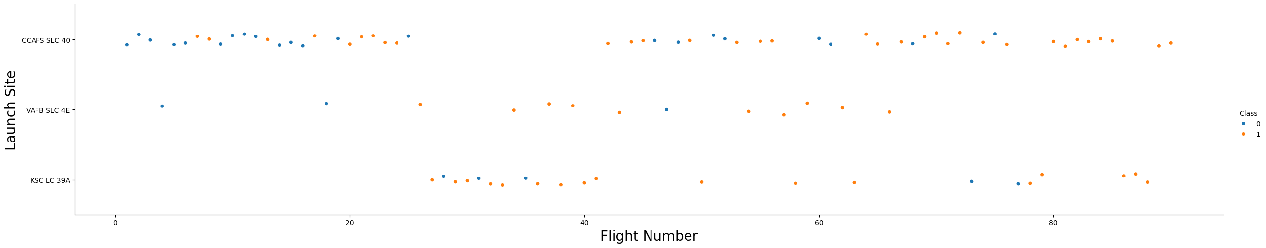
Flight Number vs. Launch Site
In this plot graph, we can conclude that the higher the Flight Number at a certain Launch Site, the higher the chance for success.
We can also see that at Launc Site ‘CCAFS SLC 40’ is where Falcon 9 launches started, in which we see many non-successful outcome, during the beginnings. This will significantly influence the summary of success rate for each Launch Site.
We also note that ‘KSC LC 39A’ Launch Site is where SpaceX commenced Falcon 9 launches the latest.
[SEE PAGE 39 FOR LAUNCH SITE SUCCES RATE PIE-GRAPH]

Slide 19
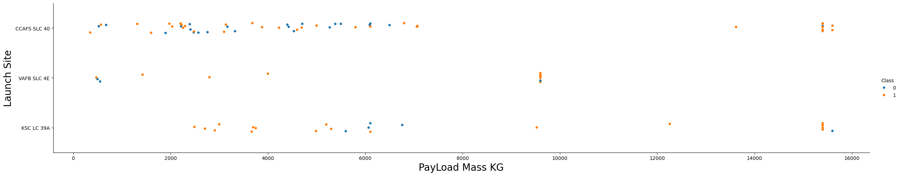
Payload vs. Launch Site
As we know the time line of each Launch site we see that the Low-Middle Weighted Payloads success rate is varies
However, we see that over ~9500 KG Payload there are clusters of high success rate.

Slide 20
Success Rate vs. Orbit Type
Considering the Orbit Type as a factor of Success we can see that
ES-L1
GEO
HEO
SSO
have 100% success rate

Slide 21
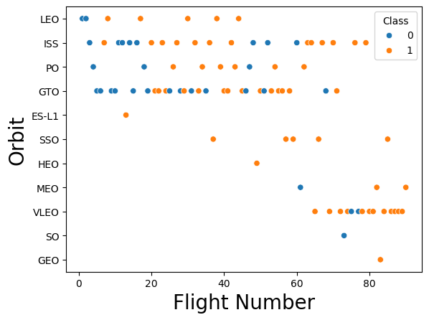
Flight Number vs. Orbit Type
As it shown, ISS launches have a clear pattern of gaining experience by going through several failures lead to more successful outcome, while GTO Orbit missions have the most failures.

Slide 22
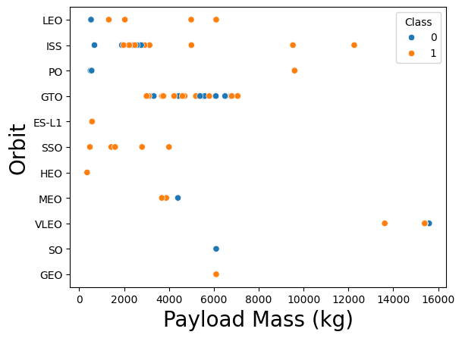
Payload vs. Orbit Type
VLEO orbit missions have the heaviest payloads, While SSO mission have one of the lowest.
GTO Orbit Missions with lower weighted payloads have more success rate than their heavily weighted payloads. We can see a pattern where we can cut the payload ranges visually into two sides.

Slide 23
Launch Success Yearly Trend
There is a clear trend of improvement with a significant decline in 2018 and a bounce back in 2019.

Slide 24
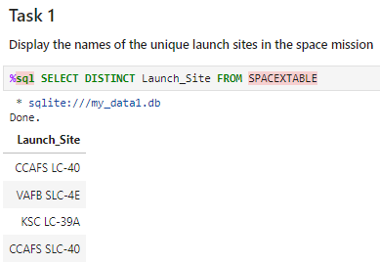
All Launch Site Names
With using SELECT DISTINCT, we retrieve all the Unique values/names of Launch_Site column.

Slide 25
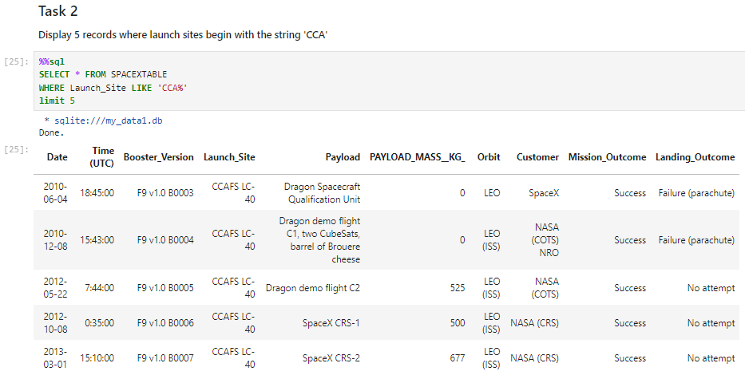
Launch Site Names Begin with 'CCA'
To find all Launch Sites that begin with 'CCA', use the SQL LIKE function with the % wildcard.
The % symbol represents any sequence of characters, so 'CCA%' matches any string starting with 'CCA'

Slide 26
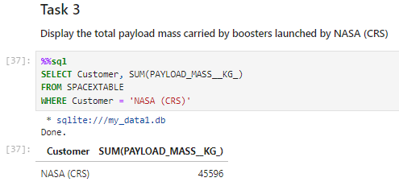
Total Payload Mass
We use the SUM function to calculate the total Payload Mass, and the WHERE clause to specify the criteria for NASA on Customer column.

Slide 27
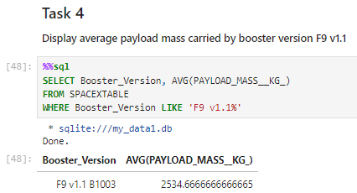
Average Payload Mass by F9 v1.1
SELECT Booster_Version, AVG(PAYLOAD_MASS__KG_) AS Average_Payload_Mass: Selects the Booster_Version and calculates the average of PAYLOAD_MASS__KG_. The result is aliased as Average_Payload_Mass.
FROM SPACEXTABLE: Specifies the table from which to retrieve the data (SPACEXTABLE in this case).
WHERE Booster_Version LIKE 'F9 v1.1%': Filters the rows to include only those where the Booster_Version starts with 'F9 v1.1'.
GROUP BY Booster_Version: Groups the results by Booster_Version.

Slide 28
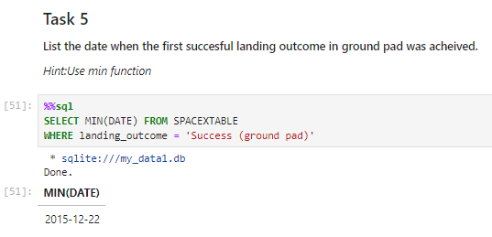
First Successful Ground Landing Date
By using MIN(DATE) and the WHERE Clause on landing_outcome, we retrieve the first Successful landing outcome on ground pad.

Slide 29
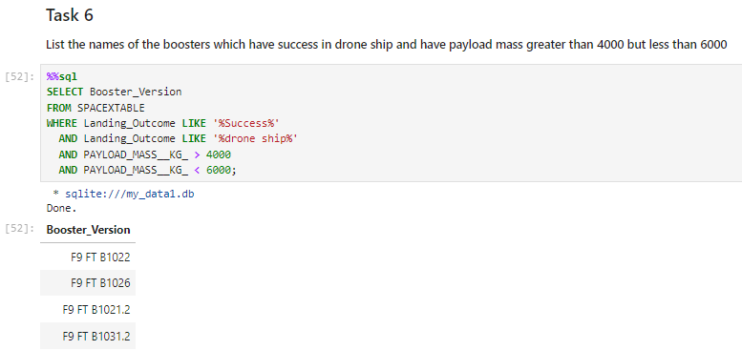
Successful Drone Ship Landing with Payload between 4000 and 6000
Using % Wildcard to retrieve any Success drone ship outcome
adding AND Conditions WHERE values are < less than or > greater than certain numbers will retrieve the names of Booster versions where Payload mass is > greater than 4k and < less than 6k

Slide 30
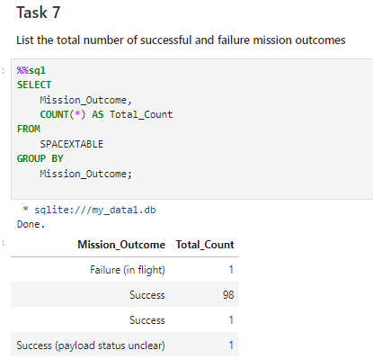
Total Number of Successful and Failure Mission Outcomes
SELECT Mission_Outcome, COUNT(*) AS Total_Count: This line selects the Mission_Outcome column and counts the number of occurrences for each unique mission outcome. The result is aliased as Total_Count.
FROM launches: Specifies the table from which to retrieve the data (launches in this case).
GROUP BY Mission_Outcome: Groups the results by each unique value in the Mission_Outcome column.

Slide 31
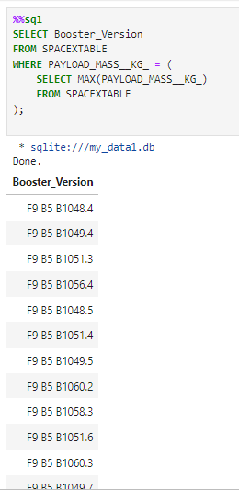
Boosters Carried Maximum Payload
This query retrieves the Booster_Version values for records where the PAYLOAD_MASS__KG_ is equal to the maximum payload mass.
The MAX function is used in a subquery to find the highest value of PAYLOAD_MASS__KG_ in the SPACEXTABLE.

Slide 32
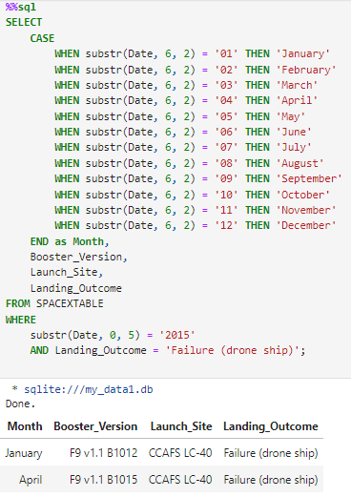
2015 Launch Records
This query converts the numerical month from the Date column to the corresponding month name using a CASE statement.
It selects the Booster_Version, Launch_Site, and Landing_Outcome columns.
The WHERE clause filters the records to only include those from the year 2015 and with a landing outcome of 'Failure (drone ship)'.

Slide 33
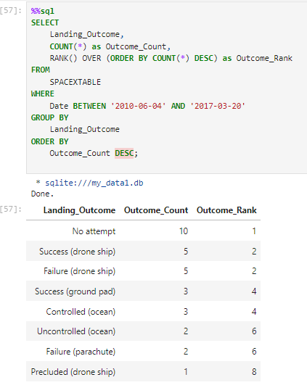
Rank Landing Outcomes Between 2010-06-04 and 2017-03-20
SELECT Landing_Outcome, COUNT(*) as Outcome_Count: Selects the Landing_Outcome and counts the number of occurrences for each landing outcome.
RANK() OVER (ORDER BY COUNT(*) DESC) as Outcome_Rank: Assigns a rank to each landing outcome based on the count, in descending order.
FROM launches: Specifies the table from which to select the data.
WHERE Date BETWEEN '2010-06-04' AND '2017-03-20': Filters the rows to include only those between the specified dates.
GROUP BY Landing_Outcome: Groups the results by Landing_Outcome to count each unique outcome.
ORDER BY Outcome_Count DESC: Orders the results by the count in descending order.

Slide 34

Section 3

Slide 35
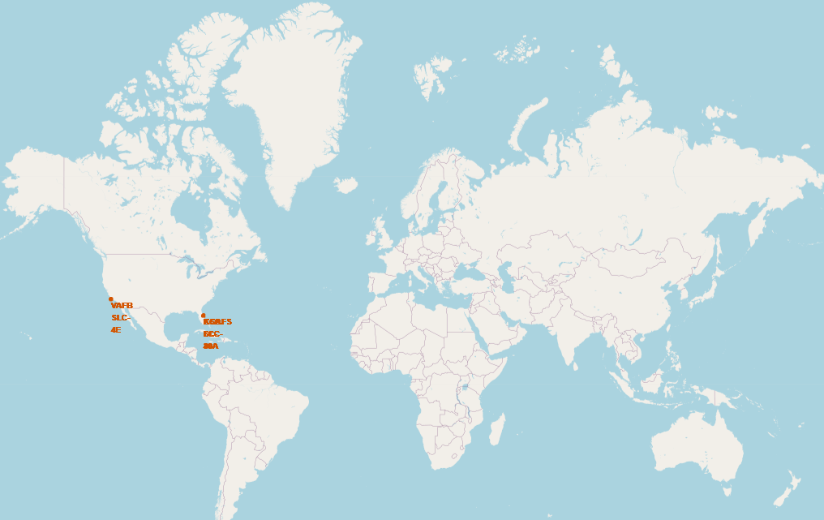
Global Map marked with All Launch sites.
Falcon 9 Launch sites are located in the United States, such as in Florida (FL) and in California (CA).

Slide 36
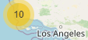
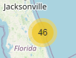
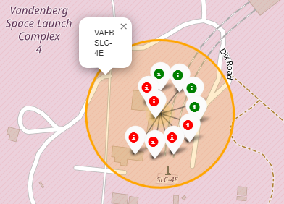
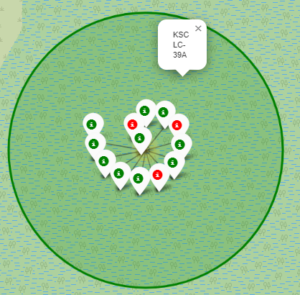
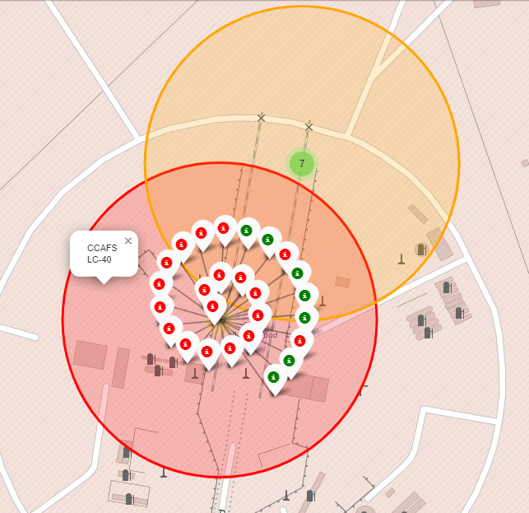
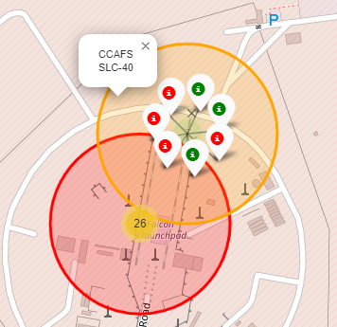
Map of Launch sites and their success rate markers
CA. Launch Site
FL. Launch Site
There are 10 launches count in California and 46 Launches count in Florida.
Circles are representing the location of Launch sites colored by Average Success rate.
Low Success rate with RED, Moderate Success rate with ORANGE and High Success Rate with GREEN
Markers and their colors representing each Launch indicating either Successful or Failed outcomes.

Slide 37
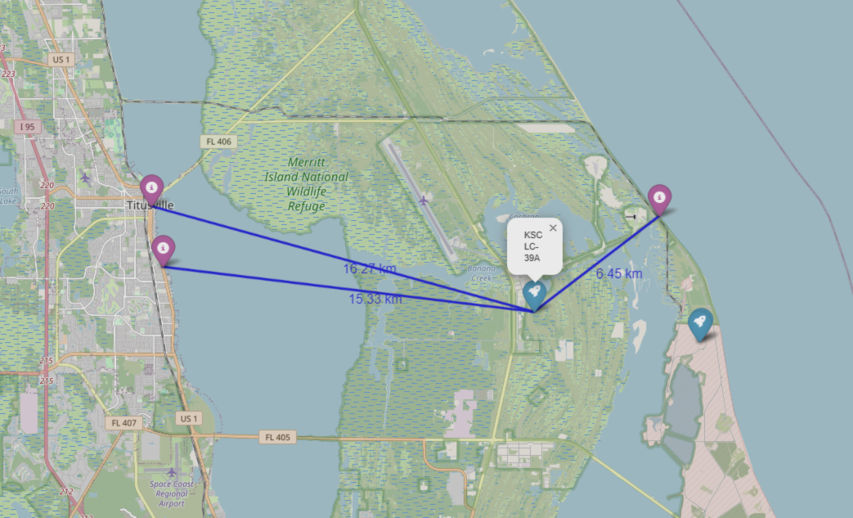
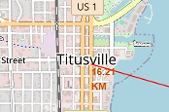
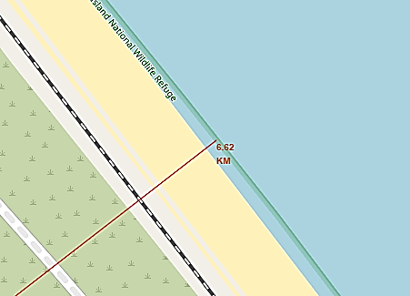
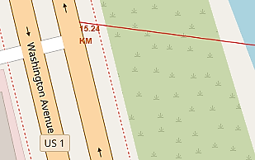
Distance from Launch Sites (KSC-LC39A)
Distance to the City
Acceptable Margin: Over 10 miles provides a reasonable safety buffer from populated areas.
Distance to the Coastline
Typical Proximity: Close to the coastline for safe disposal of rocket stages over the ocean.
Distance to the Highway
Minimal Safety Distance: Just under 10 miles but still practical with proper safety protocols.

Slide 38

Section 4

Slide 39
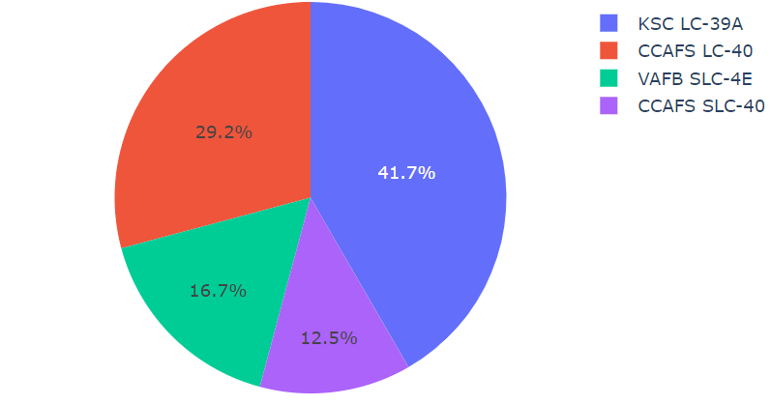
Total count of successful launches by Launch Site
The most successful launches occurred from KSC LC39A Launch Site Occupying the whole chart with 41.7%.
Followed by CCAFS LC-40 (29.2%) and VAFB SLC-4E (16.7%)
The least numbers of successful launches occurred from CCAFS SLC-40 occupying only 12.5% of the whole chart.

Slide 40
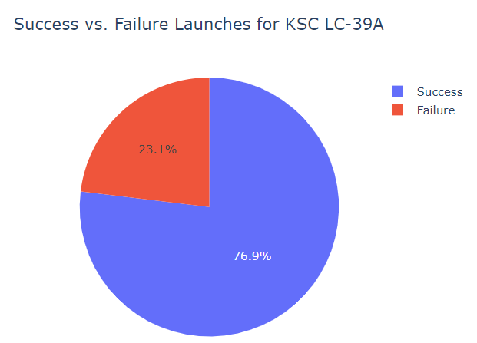
Launch Site with the most success rate
KSC LC-39A performed the most success rate of 76.9% of successful launches while getting 23.1% of failure rate.

Slide 41
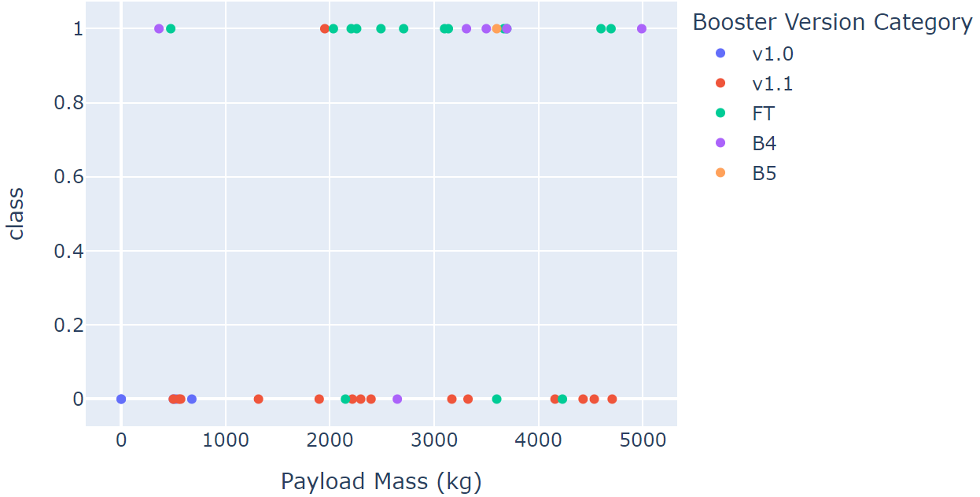
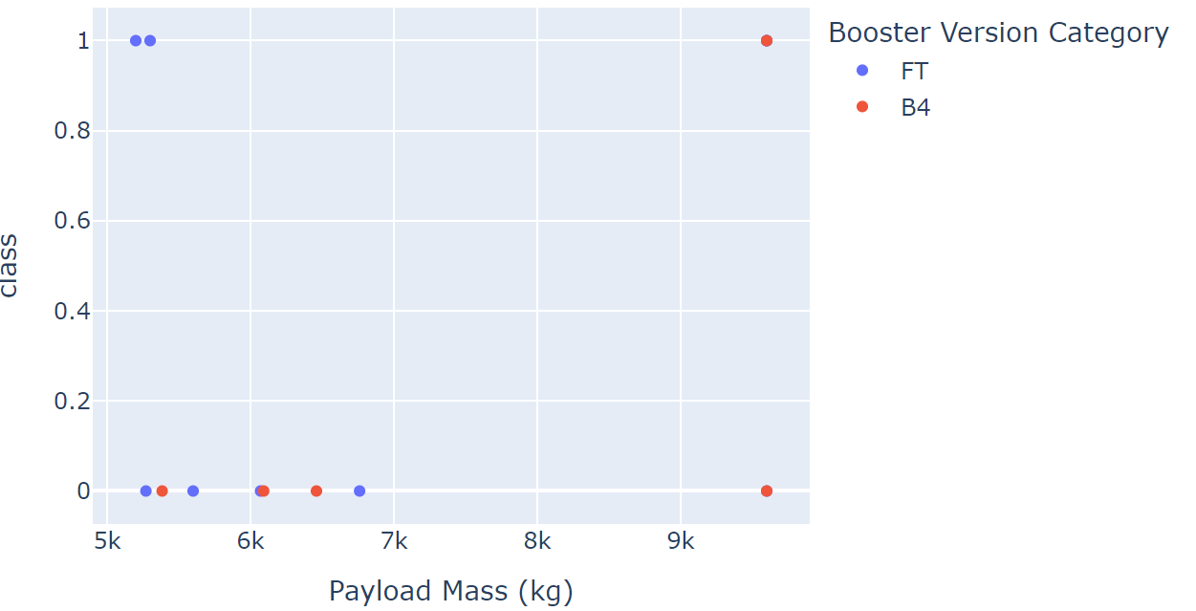
Payload Mass vs. Success
We can clearly see that Payloads above 5k have less success ratio rate and only ‘FT’ and ‘B4’ boosters are representing Heavily Weighted Payloads.
On the Low Middle Weighted Payloads we can see more successful rate and more versions of boosters.
The most successful Launches are clustering between 2k and 4k Payload Mass mostly represented by the Booster Version of ‘F4’.
Low-Middle Weighted payloads
Middle-Heavily Weighted payloads

Slide 42

Section 5

Slide 43
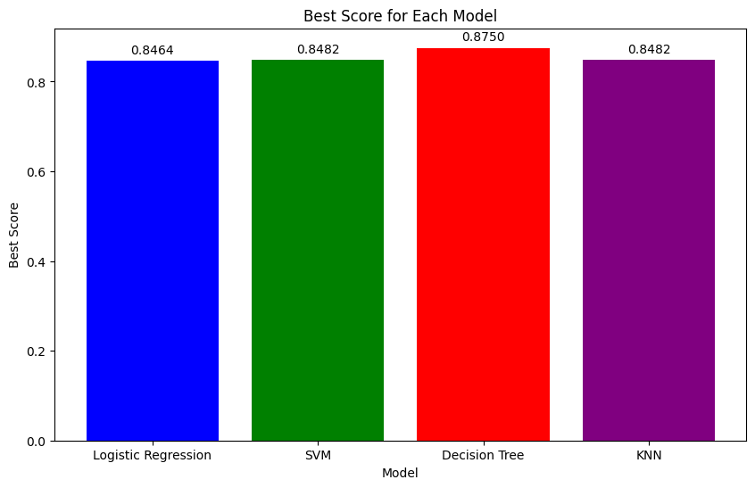
Classification Accuracy
Decision Tree has the best score of 0.875

Slide 44

Confusion Matrix
The confusion matrix shows that when it predicts ‘land’ it 100% lands.
However, if it predicts “did not land” it performs 50%
Did not land: 3/6 (50%)
Landed: 12/12(100%)
Overall accuracy: 15/18(83.333%)

Slide 45
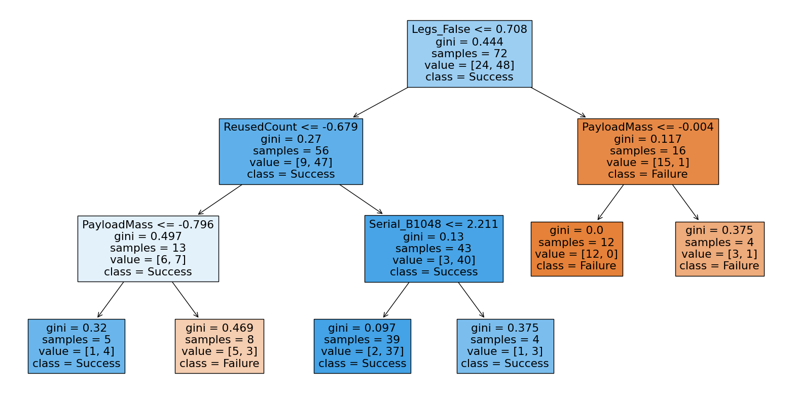
Visualizing Decision Tree results

Slide 46
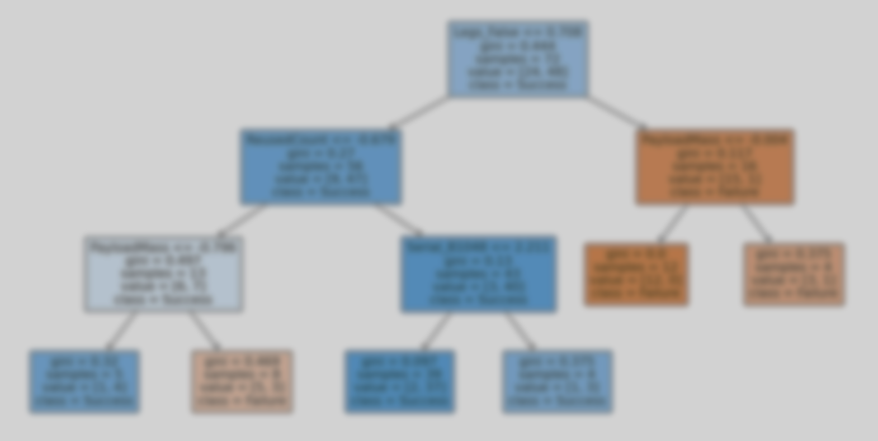
Interpretation of Decision Tree results
1. Landing Legs Configuration
Critical Factor: Presence of landing legs significantly impacts launch success.
2. Rocket Reuse Count
Critical Factor: The number of times a rocket is reused is inversely related to its success rate.
3. Payload Mass Management
Critical Factor: The mass of the payload affects the likelihood of success.
4. Serial Number Performance
Critical Factor: Specific rocket serial numbers are linked to better performance..

Slide 47
Conclusions
The larger the flight amount at a launch site, the greater the success rate at a launch site.
KSC LC-39A is holding the highest success rate of launches.
The significant rise of Launch success rate commenced in 2013.
Orbits: ES-L1, GEO, HEO, SSO are holding a 100% success rate each.
Another mentionable Orbit: There are significantly more Launces targeting VLEO - than previously mentioned Orbits - is holding a very high success rate
The Decision tree is the best performing machine learning algorithm predicting the outcome amongst classifiers.
SpaceX learns.

Slide 48
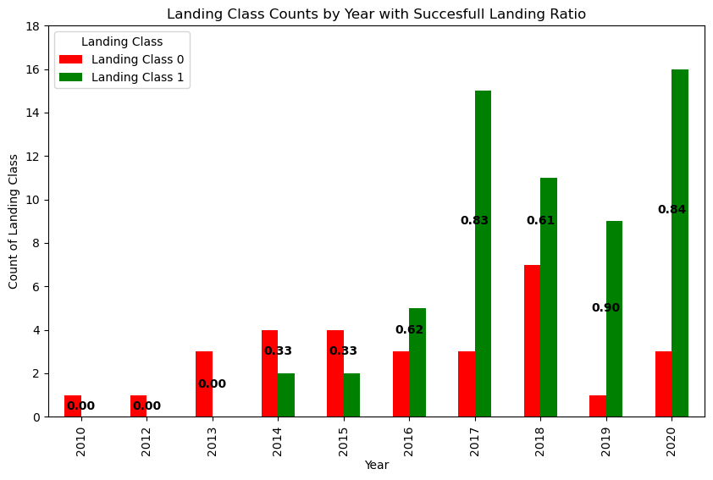
Number of Launches and improvement over time.
Improvement Over Time: SpaceX showed a clear improvement in performance year by year, with a notable increase in successful landings as the number of launches grew.
Initial Decline: Following a period of rapid progress, there was a significant decline in success rates and a reduction in the number of launches.
High Success Rate Achievement: After the downturn, SpaceX achieved a remarkable 90% success rate with a modest number of launches.
Record Launches and Success Ratio: The subsequent year saw the highest number of launches and the second-highest ratio of successful landings.
Ongoing Commitment: This trajectory underscores SpaceX's ongoing dedication to enhancing reliability and expanding launch capabilities

Slide 49


